Slide 1
Rapid Population Growth
LO:
To outline trends in global population growth and consider how it’s rapid growth puts pressure on quality of life

Slide 2
Starter:
http://www.worldometers.info/world-population/
Define the terms
- Birth rate Number of babies born per 1000 of a population per year
- Death rate Number of deaths per 1000 of a population per year
- Natural The birth rate minus the death rate
increase

Slide 3
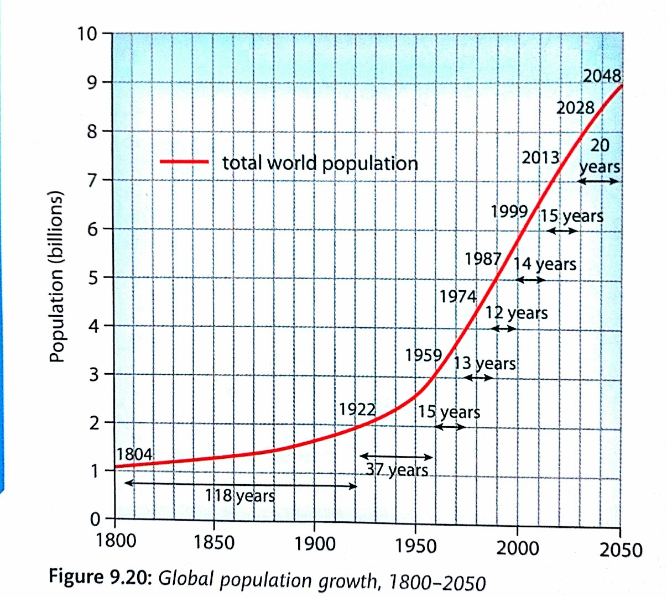
Task: complete as FULL SENTENCES
What was the worlds population in 1800?
How many years did it take to double since then?
What is the current population of the world?
Approximately how long ago was it half of this value?
What is the population predicted to be by 2050?
Define the term ‘exponential growth’

Slide 4
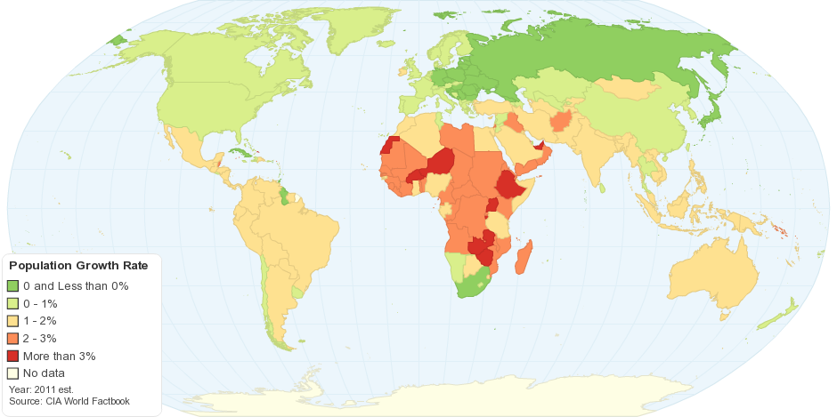
Growth Rate
https://www.youtube.com/watch?v=fTznEIZRkLg

Slide 5
Describe which countries in the world have the highest rates of growth, give some examples
Study table 9.5, what does this tell you about the growth rate of Burkina Faso? Use data in your answer
What is causing such high rates of natural increase in Burkina Faso?

Slide 6
What problems are associated with rapid population growth?

